Slide 1


Predicting Breast Cancer Using Different ML Algorithms
Alexey Efanov

Slide 2

Data Set
For the current project Breast Cancer Wisconsin (Diagnostic) Data Set was used. The data set contains 569 instances, one target variable having two categories –M (malignant), and B (benign), and 10 feature variables
This Photo by Unknown Author is licensed under CC BY

Slide 3

Methods
1. Logistic Regression
2. K Nearest Neighbors
3. Naïve Bayes
4. Decision Tree
5. Random Forest
Support Vector Machine
This Photo by Unknown Author is licensed under CC BY-SA

Slide 4
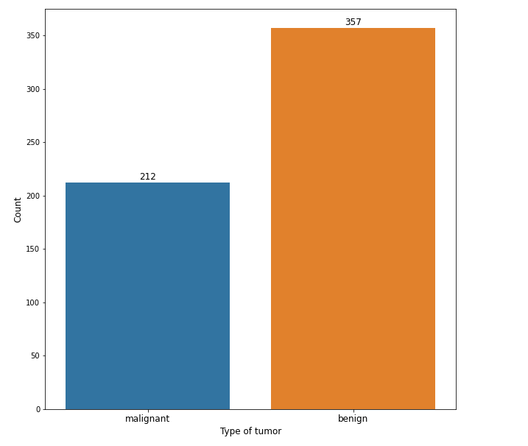
Count plot of the target variable-type of tumor

Slide 5
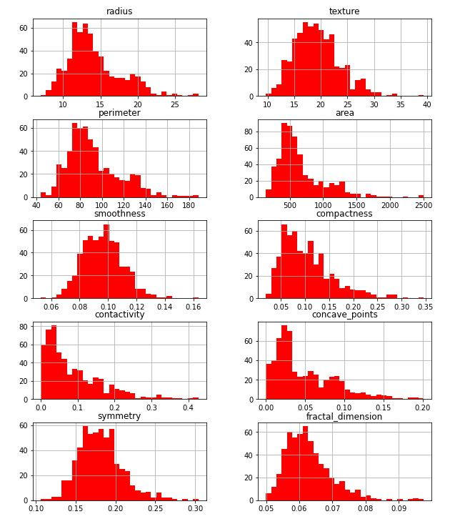
Distribution of target variables

Slide 6
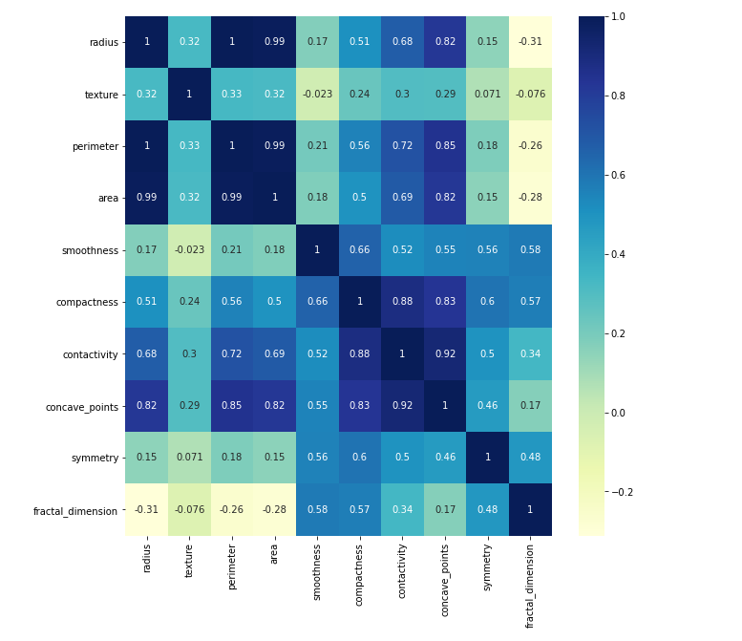
Correlation between feature variables

Slide 7
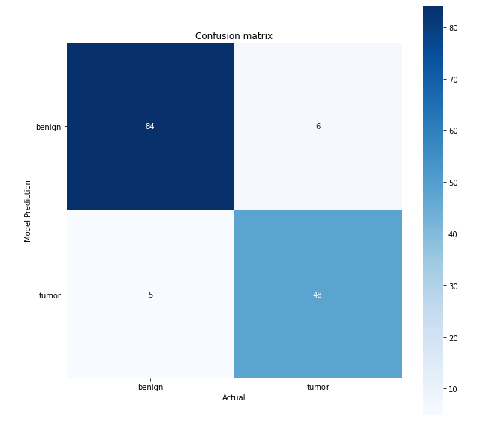
Logistic Regression
recall (benign) =0.94
recall (malignant)=0.89
accuracy=0.92

Slide 8
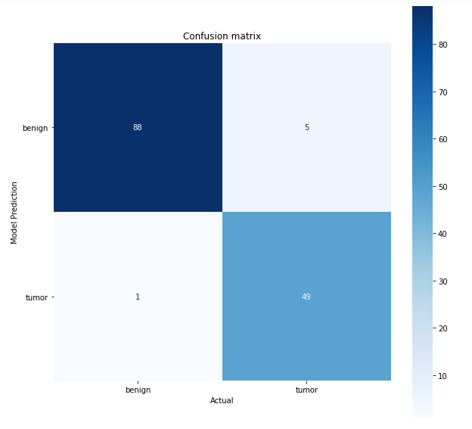
K Nearest Neighbors
recall (benign)=0.99
recall (malignant)=0.91
accuracy=0.96

Slide 9
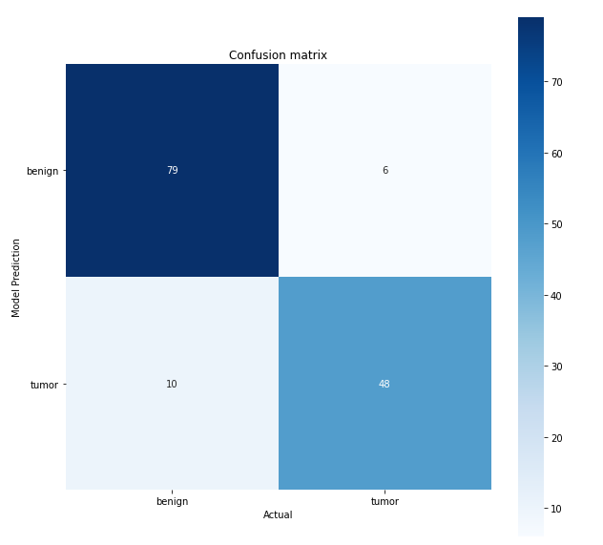
Naïve Bayes
recall (benign)=0.89
recall (malignant)=0.89
accuracy=0.89

Slide 10
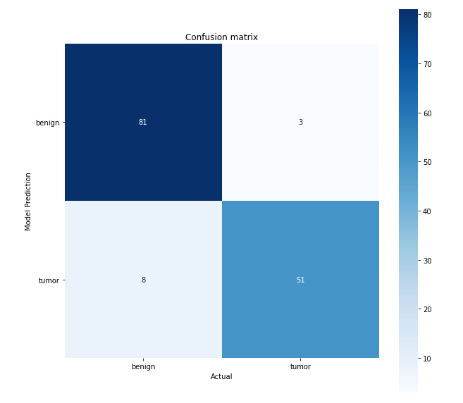
Decision Tree
recall(benign)=0.93
recall(malignant)=0.93
accuracy=0.93

Slide 11
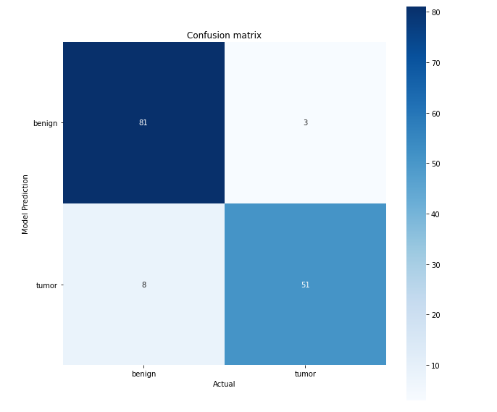
Random Forest
recall (benign)=0.91
recall (malignant)=0.94
accuracy=0.92

Slide 12

Support Vector Machine
recall (benign)=0.96
recall (malignant)=0.89
accuracy=0.93

Slide 13
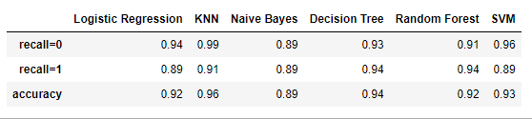
Evaluation metrics for all algorithms used in the project

Slide 14
Conclusion
K Nearest Neighbors algorithm is the most efficient in predicting breast tumor type -benign or malignant.
recall (benign)=0.99
recall (malignant)=0.91
accuracy=0.96

